Slide 1
Reinforcement Learning

Slide 2
Activity: Hot or Cold

Slide 3
Super Mario Brothers
Activity: A Volunteer to Play Super Mario Brothers
https://www.youtube.com/watch?v=ldXxDNjS5jw

Slide 4
What is Reinforcement Learning? I
As we saw in the Super Mario Bros video, reinforcement learning enables AI to master tasks through trial and error—starting with random actions and gradually improving through experience.
How a human player may approach the game:
  Try things out and see what works.
  Press a button, see what happens.
  If you score points, great! You'll probably try that again.
  If you lose a life, you'll avoid that action next time.
That is reinforcement learning in a nutshell:
learning by interacting with the world and figuring out what works.

Slide 5

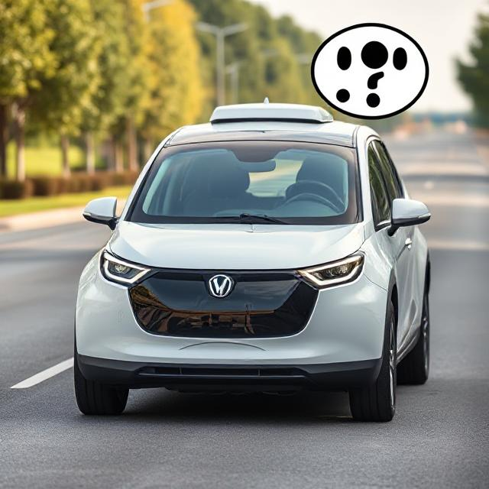
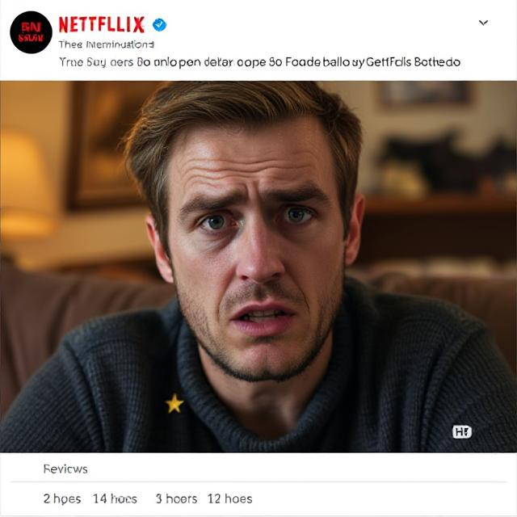

Why Does It Matter?
Reinforcement learning powers many exciting technologies:
  Self-driving cars learning to navigate roads
  Game-playing AI that beats human champions
  Robots learning to perform complex tasks
  Personalized recommendation systems
Most importantly, it mirrors how humans and animals naturally learn many skills—not by being explicitly taught, but by interacting with the world and learning from experience.
image generator

Slide 6


What is Reinforcement Learning? II
How do babies learn to walk?
The agent:
Environment:
Actions:
Rewards:
Negative:
Positive:
Goal:
Baby
The physical world (floor furniture, gravity)
Different muscle movements, shifts in weight, stepping motions
Falling down, losing balance (pain/discomfort)
Successful steps, maintaining balance, reaching
Maximize successful walking (minimize falls, maximize mobility)
Notes:
When learning to cook, you experiment with ingredients and techniques, tasting as you go and adjusting based on results.

Slide 7

Key Characteristics of Reinforcement Learning
Success comes through trial-and-error learning and experimentation
Sometimes the reward comes long after the action due to delayed consequences
You must figure out which actions lead to good outcomes through discovery-based approaches
The Challenge:
Exploitation
vs.
Exploration
At a restaurant, do you:
Order your favorite dish or
Order a new dish that might be even better

Slide 8



The Core Dilemma: Exploration vs. Exploitation
Exploration involves trying new actions to discover better strategies—gathering information about unknown reward structures and accepting short-term suboptimal performance to build long-term knowledge.
Exploitation in reinforcement learning involves sticking with actions you already know work well—using existing knowledge to maximize rewards by choosing safe actions with predictable outcomes, like an agent following a proven strategy to optimize immediate returns.
Finding the Right Balance
Too much exploitation
Too much exploration
stuck in local maxima, missing better strategies
wasted time on suboptimal actions
Notes:
Real-World Examples
Restaurant choice: Try new place or return to favorite?
Investment strategy: Test new markets or stick with proven returns?
A/B testing: Experiment with new designs or optimize what works?

Slide 9
Optimal Strategy Evolution in RL
High Exploration
Try many different actions to discover possibilities.
Gradual Shift
Increase exploitation of successful strategies.
Mostly Exploitation
Apply learned knowledge consistently.
Learning naturally shifts from exploring possibilities to using what works best

Slide 10
RL vs. Other Learning Paradigms
Supervised Learning | Unsupervised Learning | Reinforcement Learning
Learn from labeled examples | Find patterns in data | Learn from rewards
Teacher provides correct answers | No teacher | Environment provides feedback
Training / test phases | No labels needed | Continuous learning
Classification / regression | Clustering / dimensionality reduction | Sequential decision making

Slide 11
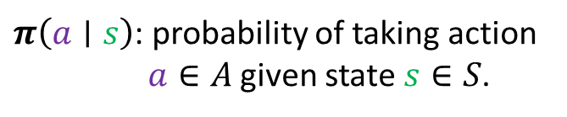



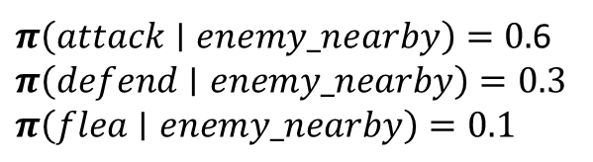

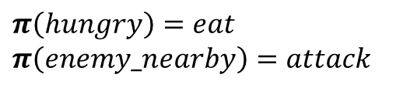

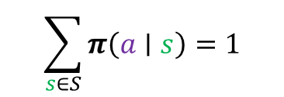
The Policy
A policy is an agent's strategy for choosing actions—it decides what to do in any given situation. Formally, a policy $π$ is a function that maps states to actions (or probability distributions over actions).
Deterministic Policy
Stochastic Policy
$$π:S→A$$
$S$: state space
$$π:S×A→\left[0,1\right]$$
where:
$A$: action space
where:
$π\left(a∣s\right)$: probability of taking action $a∈A$ given state $s∈S$.
Thus, $π\left(s\right)$ is the action chosen in state $s∈S$.
$$\sum_{s∈S}{π\left(a∣s\right)}=1$$
Example:
$$π\left(hungry\right)=eat$$
$$π\left(enemy_nearby\right)=attack$$
$π\left(attack∣enemy_nearby\right)=0.$6
$$π\left(defend∣enemy_nearby\right)=0.3$$
$$π\left(flea∣enemy_nearby\right)=0.1$$
Example:
Goal: Find the optimal policy $π^{∗}$ that maximizes expected cumulative reward.

Slide 12

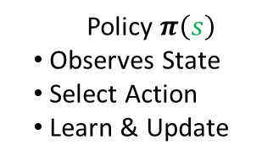
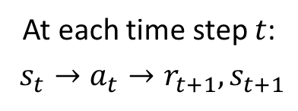
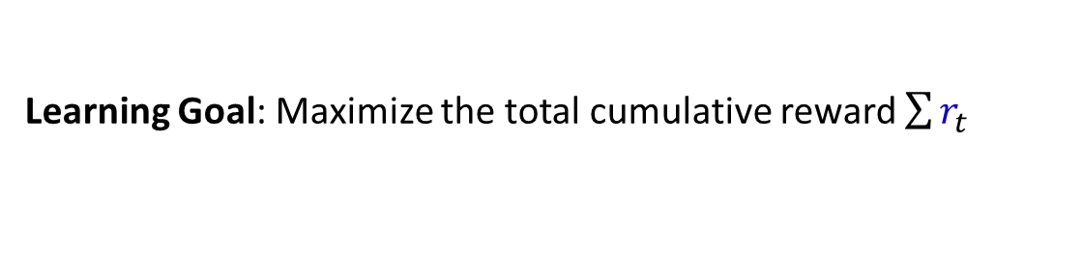


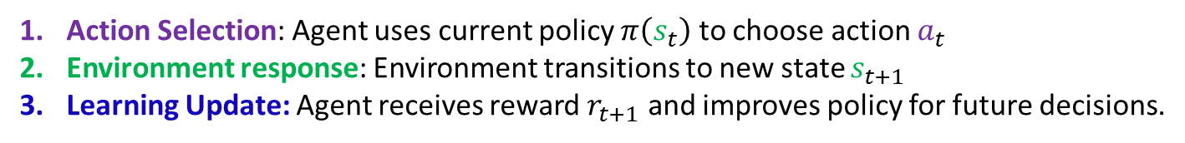

The RL Setting: Agent-Environment Loop
Action ($a$)
Agent
What To Do
Environment (World)
At each time step $t$:
$s_{t}→a_{t}→r_{t+1},s_{t+1}$
Policy $π\left(s\right)$
Observes State
Select Action
Learn & Update
State ($s$)
Process Action
Update State
Compute Reward
What I See
Reward ($r$)
How good / bad
Action Selection: Agent uses current policy $π\left(s_{t}\right)$ to choose action $a_{t}$
Environment response: Environment transitions to new state $s_{t+1}$
Learning Update: Agent receives reward $r_{t+1}$ and improves policy for future decisions.
Learning Goal: Maximize the total cumulative reward $\sum{r_{t}}$

Slide 13



Agent-Environment Loop Example I
Agent: Robot in 3x3 grid
State: Robot's position (1-9); start in 5 (center)
Actions: Up, Down, Left, Right
7 | 8 | 9
4 | 5 | 6
1 | 2 | 3
Goal: Reach position 9 (top-right corner)
(we will also stipulate in 3 moves or fewer).
Rewards: +10 for reaching goal, -1 for each step
Initial Policy: Random (25% chance for each direction)

Slide 14
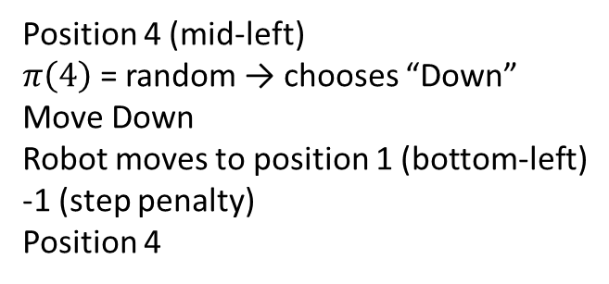
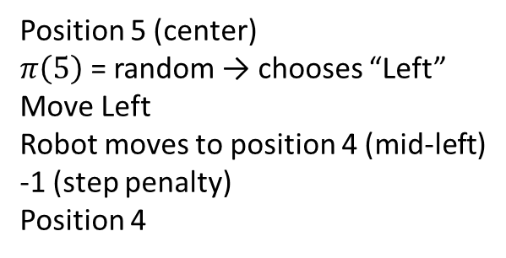
Agent-Environment Loop Example II
7 | 8 | 9
4 | 5 | 6
1 | 2 | 3
7 | 8 | 9
4 | 5 | 6
1 | 2 | 3
State:
Policy:
Action:
Environment:
Reward:
New State:
Position 5 (center)
$π\left(5\right)$ = random → chooses “Left”
Move Left
Robot moves to position 4 (mid-left)
-1 (step penalty)
Position 4
→
7 | 8 | 9
4 | 5 | 6
1 | 2 | 3
State:
Policy:
Action:
Environment:
Reward:
New State:
Position 4 (mid-left)
$π\left(4\right)$ = random → chooses “Down”
Move Down
Robot moves to position 1 (bottom-left)
-1 (step penalty)
Position 4

Slide 15
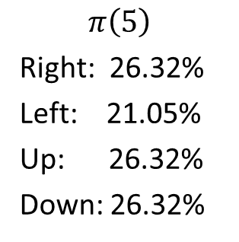
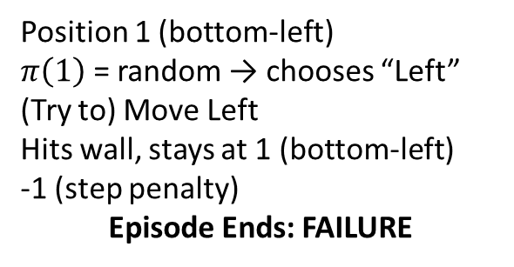
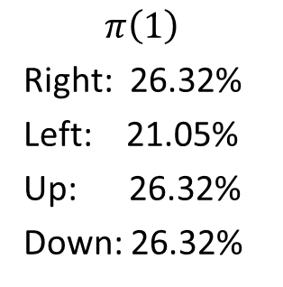
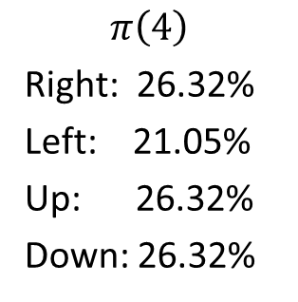
Agent-Environment Loop Example III
7 | 8 | 9
4 | 5 | 6
1 | 2 | 3
7 | 8 | 9
4 | 5 | 6
1 | 2 | 3
State:
Policy:
Action:
Environment:
Reward:
New State:
Position 1 (bottom-left)
$π\left(1\right)$ = random → chooses “Left”
(Try to) Move Left
Hits wall, stays at 1 (bottom-left)
-1 (step penalty)
Episode Ends: FAILURE
→
Policy Update:
$$π\left(5\right)$$
Right: 26.32%
Left: 21.05%
Up: 26.32%
Down: 26.32%
$$π\left(4\right)$$
Right: 26.32%
Left: 21.05%
Up: 26.32%
Down: 26.32%
$$π\left(1\right)$$
Right: 26.32%
Left: 21.05%
Up: 26.32%
Down: 26.32%
(Subtract 5% and normalize.)

Slide 16
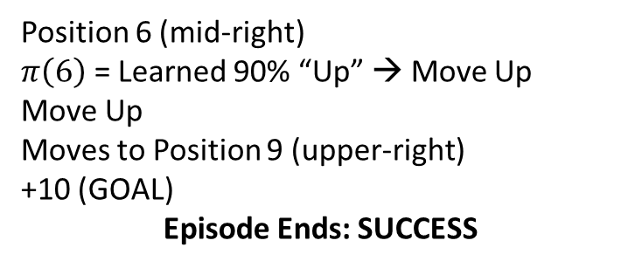
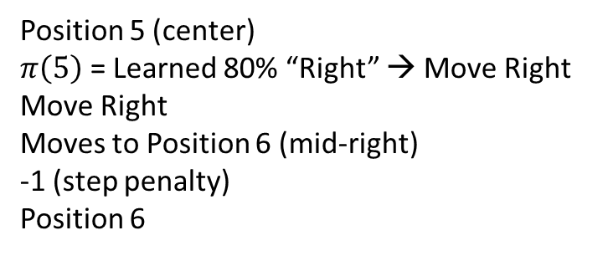
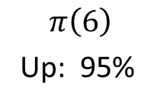
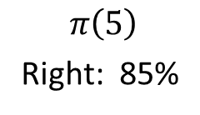
Agent-Environment Loop Example IV
Restart Episode: 50th Iteration
7 | 8 | 9
4 | 5 | 6
1 | 2 | 3
7 | 8 | 9
4 | 5 | 6
1 | 2 | 3
State:
Policy:
Action:
Environment:
Reward:
New State:
Position 5 (center)
$π\left(5\right)$ = Learned 80% “Right” → Move Right
Move Right
Moves to Position 6 (mid-right)
-1 (step penalty)
Position 6
→
State:
Policy:
Action:
Environment:
Reward:
New State:
Position 6 (mid-right)
$π\left(6\right)$ = Learned 90% “Up” → Move Up
Move Up
Moves to Position 9 (upper-right)
+10 (GOAL)
Episode Ends: SUCCESS
7 | 8 | 9
4 | 5 | 6
1 | 2 | 3
(Increase ‘Good Move’ directions; normalization of others omitted.)
$$π\left(5\right)$$
Right: 85%
$$π\left(6\right)$$
Up: 95%
Policy Update

Slide 17
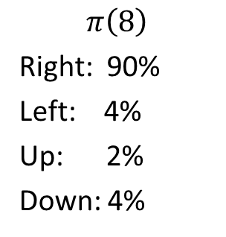
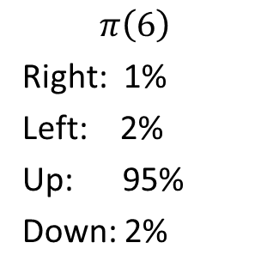
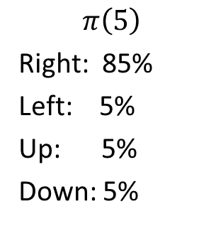

Agent-Environment Loop Example V
7 | 8 | 9
4 | 5 | 6
1 | 2 | 3
Final Learned Policy: $π^{∗}$
$$π\left(5\right)$$
Right: 85%
Left: 5%
Up: 5%
Down: 5%
$$π\left(6\right)$$
Right: 1%
Left: 2%
Up: 95%
Down: 2%
$$π\left(8\right)$$
Right: 90%
Left: 4%
Up: 2%
Down: 4%
Summary
Episode 1: Random movement, hitting walls, never reaching goal
Episode 50: Direct path to goal in just 2 steps
Policy Evolution: From random movement to 85-95% optimal moves.
The robot learned the shortest path to the goal purely through trial and error, with the policy encoding the optimal route!

Slide 18
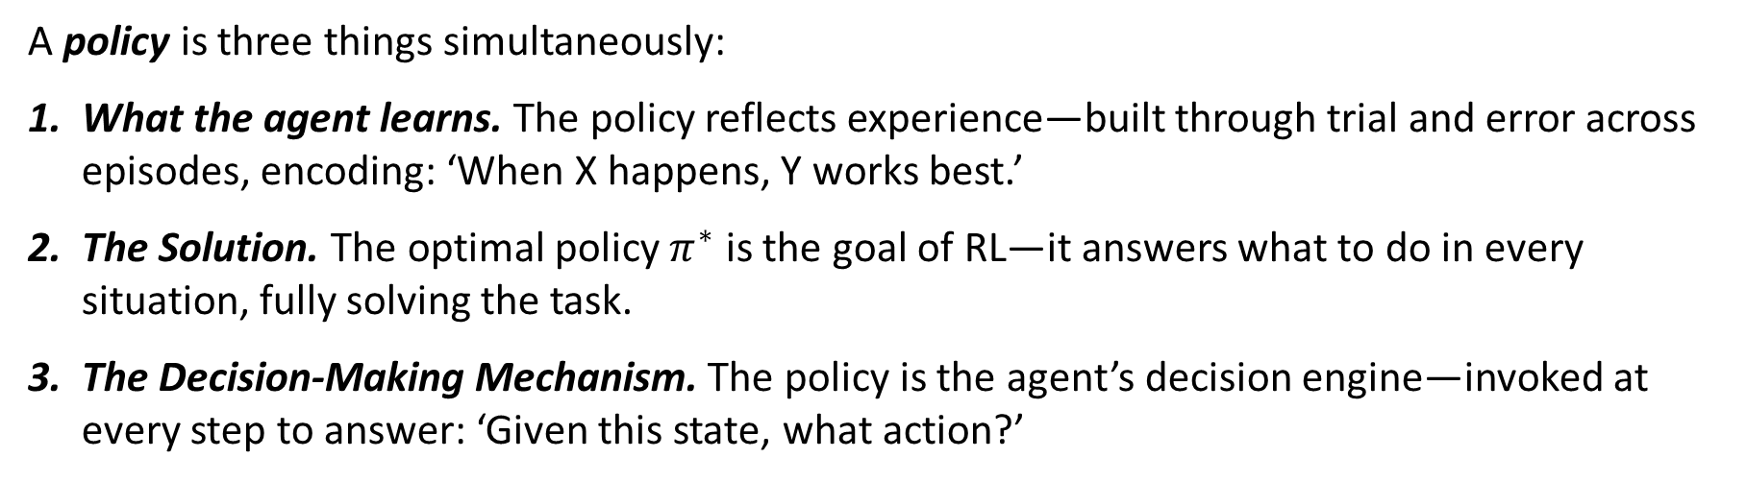
The Three Faces of a Policy
A policy is three things simultaneously:
What the agent learns. The policy reflects experience—built through trial and error across episodes, encoding: ‘When X happens, Y works best.’
The Solution. The optimal policy $π^{∗}$ is the goal of RL—it answers what to do in every situation, fully solving the task.
The Decision-Making Mechanism. The policy is the agent’s decision engine—invoked at every step to answer: ‘Given this state, what action?’
This is what makes RL so elegant—the learning process, the solution, and the execution mechanism are all the same thing. The agent does not acquire knowledge about optimal behavior; it directly develops the policy that IS the optimal behavior.

Slide 19
Some Real-World RL Examples
Some concrete examples where RL has been successful.
Game Playing
  AlphaGo/AlphaZero: Mastered Go, Chess, Shogi
  Atari Games: Human-level performance from pixels (Breakout, Pong, Space Invaders)
  StarCraft II: AlphaStar reached Grandmaster level
  Dota 2: OpenAI Five competed against professional players
  Poker: Libratus and Pluribus beat top human players
  Hide and Seek: OpenAI agents developed complex strategies
Robotics
  Robot Grasping: Learning to pick up various objects
  Autonomous Vehicles: Tesla, Waymo navigation systems
  Drone Navigation: Obstacle avoidance and path planning
  Robotic Surgery: Precision movements in medical procedures
  Warehouse Automation: Amazon’s robotic fulfillment centers
  Humanoid Robots: Boston Dynamics Atlas parkour movements
Business & Finance
  Algorithmic Trading: High-frequency trading strategies
  Portfolio Management: Dynamic asset allocation
  Pricing Optimization: Airlines, hotels adjusting prices
  Fraud Detection: Credit card companies detecting anomalies
  Supply Chain: Inventory management and logistics
  Advertisement: Real-time bidding for online ads
Healthcare & Science
  Drug Discovery: Finding new pharmaceutical compounds
  Personalized Medicine: Treatment recommendations
  Clinical Trial Design: Optimizing patient recruitment
  Protein Folding: AlphaFold predicting 3D structures
  Medical Imaging: Improving diagnostic accuracy
  Epidemic Control: Optimizing intervention strategies

Slide 20


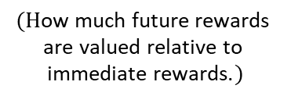









Markov Decision Process
How do we formalize RL problems mathematically? We need a framework that captures the essential elements: states, actions, rewards, and transitions. (Again, this might seem slightly familiar.)
$$a_{0}$$
$$a_{1}$$
$$a_{2}$$
. . .
$$s_{0}$$
$$s_{1}$$
$$s_{2}$$
A Markov Decision Process (MDP) is defined by:
$S$: Set of states
$P\left(s^{′}∣s,a\right):$ Transition probabilities.
$γ∈\left[0,1\right]:$ Discount factor
$A$: Set of actions
$R\left(s,a,s′\right):$ reward function
$$(\text{H}\text{ow} \text{much} \text{future} \text{rewards} \text{are} \text{valued} \text{relative} \text{to} \text{immediate} \text{rewards}\text{.})$$
The Markov property. This is the key assumption—the future depends only on the current state, not on how you got there. Formally,
$P\left(s_{t+1}∣s_{t}, a_{t}, s_{t−1}, a_{t−1}, …\right)=P\left(s_{t+1}∣s_{t}, a_{t}\right)$.
Goal: Find an optimal policy $π^{∗}\left(s\right)$ that tells you which action to take in each state to maximize expected cumulative discounted reward over time.

Slide 21
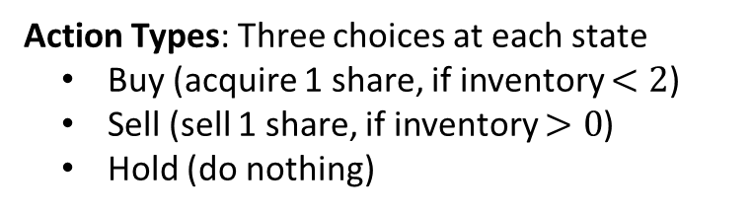
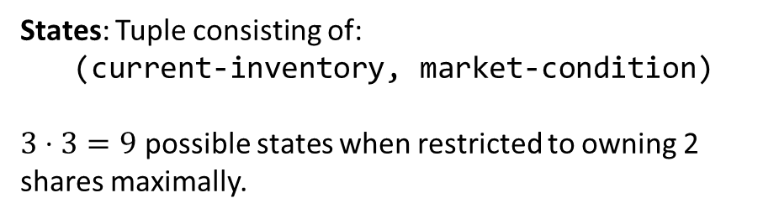
MDP Example I
Agent: a bot deciding whether to buy, sell, or hold a stock each day based on current inventory and market conditions.
Action Types: Three choices at each state
  Buy (acquire 1 share, if inventory $<2$)
  Sell (sell 1 share, if inventory $>0$)
  Hold (do nothing)
States: Tuple consisting of:
(current-inventory, market-condition)
$3⋅3=9$ possible states when restricted to owning 2 shares maximally.
Rewards:
  Sell during Bullish market: +$10
  Sell during Neutral market: +$5
  Sell during Bearish market: -$2
  Buy: -$3 (transaction cost)
  Hold: $0
Transition→ | Bullish | Bearish | Neutral
Bullish | 0.6 | 0.3 | 0.1
Bearish | 0.6 | 0.3 | 0.1
Neutral | 0.4 | 0.3 | 0.3

Slide 22












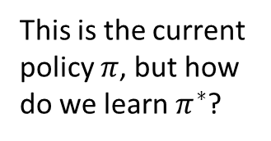









MDP Example II: $π$
0 shares
1 share
2 shares
(0, Bullish)
Bullish
(1, Bullish)
Bullish
(2, Bullish)
Bullish
Actions
Actions
Actions
Buy Share
$$−\$3$$
Buy Share
$$−\$3$$
Buy Share
Max
This is the current policy $π$, but how do we learn $π^{∗}$?
Sell
N/A
Sell
$$+\$10$$
Sell
$$+\$10$$
Hold
$$\$0$$
Hold
$$\$0$$
Hold
$$\$0$$
(0, Neutral)
Neutral
(1, Neutral)
Neutral
(2, Neutral)
Neutral
That is, we have our MDP formulation, but how do we find the best strategy?
Actions
Actions
Actions
Buy Share
$$−\$3$$
Buy Share
$$−\$3$$
Buy Share
MAX
Sell
N/A
Sell
$$+\$5$$
Sell
$$+\$5$$
Hold
$$\$0$$
Hold
$$\$0$$
Hold
$$\$0$$
(0, Bearish)
Bearish
(1, Bearish)
Bearish
(2, Bearish)
Bearish
Actions
Actions
Actions
First, we need to define how to measure the quality of different strategies.
Buy Share
$$−\$3$$
Buy Share
$$−\$3$$
Buy Share
MAX
Sell
N/A
Sell
$$−\$2$$
Sell
$$−\$2$$
Hold
$$\$0$$
Hold
$$\$0$$
Hold
$$\$0$$

Slide 23
Value Functions
Imagine you are a financial advisor evaluating different investment portfolios:
An experienced investor might say:
  “Portfolio A has a value of $1.2M expected over 10 years”
  “Portfolio B has a value of $800K expected over 10 years”
  “Portfolio C has a value of $1.0M expected over 10 years”
Portfolio A: Tech stocks, high growth potential
Portfolio B: Government bonds, stable but low returns
Portfolio C: Mixed portfolio with diversified holdings
The investor is estimating the expected future returns from each starting position, considering all possible market scenarios and the investment strategy they will follow.
“Value function” refers to a measure of future reward potential—it is a way of estimating how promising a situation is over time.

Slide 24

Value Functions
Similarly, in RL we want to know: “How good is this state for achieving high rewards in the future?”
2.3 | 3.1 | 4.2 | +1 (terminal)
1.8 | X (barrier) | 2.9 | -1 (terminal)
Start | 1.2 | 2.1 | 2.5
The other values are state values.
Considering the top-left corner, if we start in this state and follow the policy, we expect to accumulate 2.3 total reward, on average.
Observe higher numbers are better positions:
Closer to +1 reward (goal)
Farther from -1 penalty (trap)
Fewer steps needed (less accumulated step costs)
TODO: complete

Slide 25
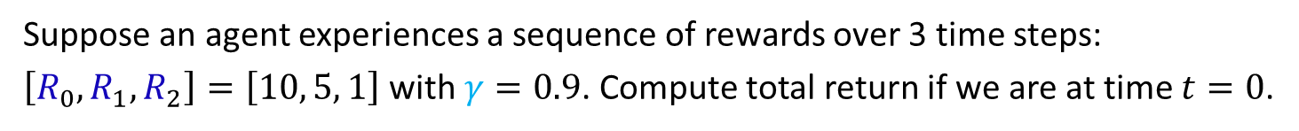
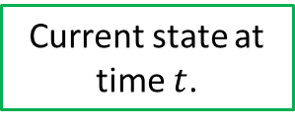

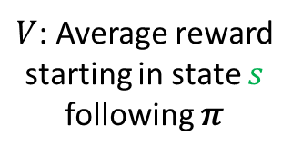
State Value Function: $V^{π(s)}$
Definition. The expected cumulative reward from state $s$ following policy $π$:
Discrete Probability Distribution
Reward one step in the future; discounted once
Current state at time $t$.
$$V^{π(s)}=E\left[R_{t}+γR_{t+1}+γ^{2}R_{t+2}+…∣s_{t}=s, π\right]$$
$γ$
Discount factor
$V$: Average reward starting in state $s$ following $π$
Immediate reward; no discounting
Reward two steps in the future; discounted twice
policy
Example.
Suppose an agent experiences a sequence of rewards over 3 time steps:
$\left[R_{0},R_{1},R_{2}\right]=\left[10, 5, 1\right]$ with $γ=0.9$. Compute total return if we are at time $t=0$.
Solution.
Total Return $=10+γ⋅5+γ^{2}⋅1=10+0.9⋅5+{0.9}^{2}⋅1=15.31$

Slide 26
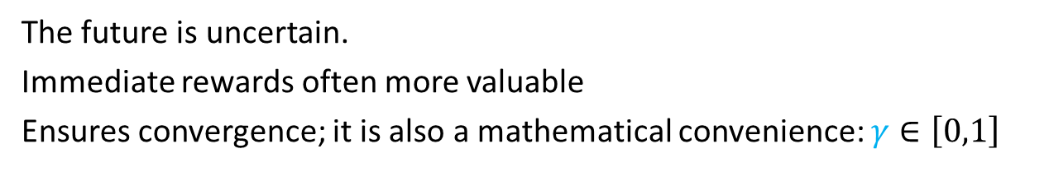

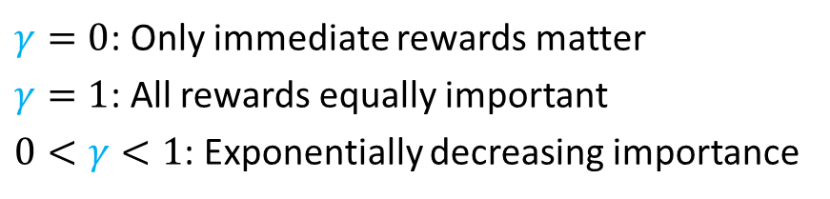
Discounting Future Rewards
Why not just sum all rewards equally?
In many real problems, getting a reward now is better than getting the same reward later.
This is where discounting becomes crucial.
Why discount?
The future is uncertain.
Immediate rewards often more valuable
Ensures convergence; it is also a mathematical convenience: $γ∈\left[0,1\right]$
$γ=0$: Only immediate rewards matter
$γ=1$: All rewards equally important
$0<γ<1$: Exponentially decreasing importance
$γ∈\left[0,1\right]$:

Slide 27


Action Value Function: $Q^{π(s)}$
Definition. The expected cumulative reward from taking action $a$ in state $s$, then following policy $π$:
Discrete Probability Distribution
Reward one step in the future; discounted once
Current state at time $t$.
$γ$
$$Q^{π(s,a)}=E\left[R_{t}+γR_{t+1}+γ^{2}R_{t+2}+…∣s_{t}=s,a_{t}=a,π\right]$$
Discount factor
$V$: Average reward starting in state $s$ following $π$
Immediate reward; no discounting
Reward two steps in the future; discounted twice
policy
$$TODO:finish$$

Slide 28
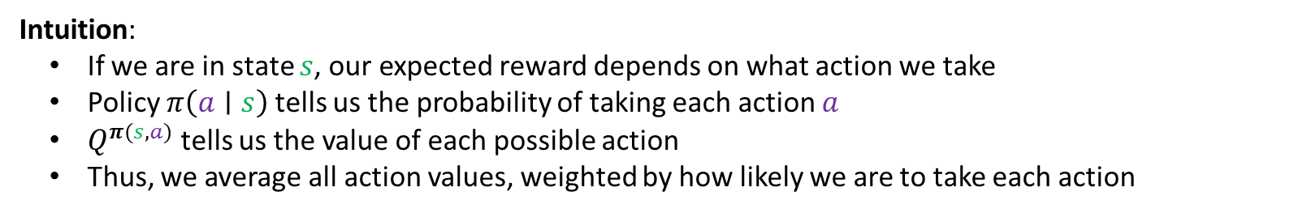
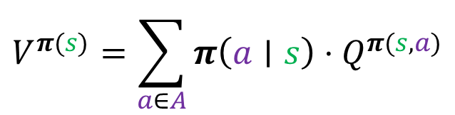
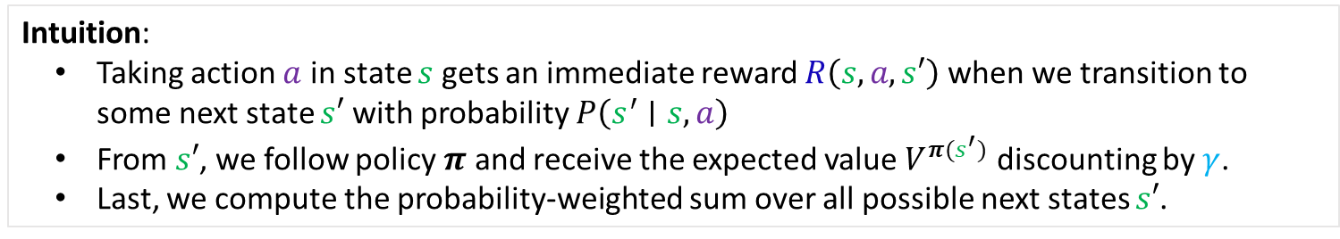
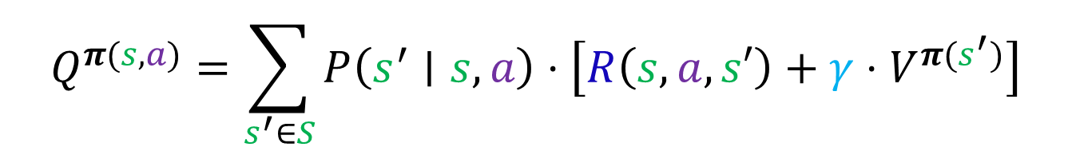
Relationships Between State and Action Value Functions
$$V^{π(s)}=\sum_{a∈A}{π\left(a∣s\right)⋅Q^{π(s, a)}}$$
State value equals the expected value of action values under the policy:
Intuition:
If we are in state $s$, our expected reward depends on what action we take
Policy $π\left(a∣s\right)$tells us the probability of taking each action $a$
$Q^{π(s,a)}$tells us the value of each possible action
Thus, we average all action values, weighted by how likely we are to take each action
Action value equals the expected value of immediate reward plus discounted future value :
$$Q^{π(s, a)}=\sum_{s^{′}∈S}{P\left(s^{′}∣s,a\right)⋅\left[R\left(s,a,s′\right)+γ{⋅V}^{π(s^{′})}\right]}$$
Intuition:
  Taking action $a$ in state $s$ gets an immediate reward $R\left(s,a,s′\right)$ when we transition to some next state $s′$ with probability $P\left(s^{′}∣s,a\right)$
  From $s′$, we follow policy $π$ and receive the expected value $V^{π(s^{′})}$ discounting by $γ$.
  Last, we compute the probability-weighted sum over all possible next states $s′$.

Slide 29
Value Functions
Similarly, in RL we want to know: “How good is this state for achieving high rewards in the future?”
2.3 | 3.1 | 4.2 | 1
1.8 | X | 2.9 | -1
S | 1.2 | 2.1 | 2.5
We need to define what “best” means and how to measure the quality of different strategies…
Why are value functions essential? - They tell us how good each state (or state-action) is - Enable comparison between different policies - Foundation for RL algorithms
Policy π
  Deterministic: π(s) → a
  Stochastic: π(a|s) → probability of action a in state s
State Value Function V^π(s)
  Expected cumulative reward from state s following policy π
  V^π(s) = E[R_t + γR_{t+1} + γ²R_{t+2} + … | S_t = s, π]
Action Value Function Q^π(s,a)
  Expected cumulative reward from taking action a in state s, then following π
  Q^π(s,a) = E[R_t + γR_{t+1} + γ²R_{t+2} + … | S_t = s, A_t = a, π]
The value in "value function" refers to the expected future reward - essentially asking "How good is it to be in this situation?"

Slide 30
Bellman Equations
HERE
We’ve defined value functions, but how do we compute them? It turns out there’s an elegant recursive relationship that connects the value of a state to the values of its successor states…
Why are Bellman equations fundamental? - Express value functions recursively - Foundation for dynamic programming algorithms - Key insight: optimal decisions have optimal substructure
State Value Bellman Equation
V^π(s) = Σ_a π(a|s) Σ_{s’} P(s’|s,a) [R(s,a,s’) + γV^π(s’)]
Action Value Bellman Equation
Q^π(s,a) = Σ_{s’} P(s’|s,a) [R(s,a,s’) + γΣ_{a’} π(a’|s’)Q^π(s’,a’)]
Bellman Optimality Equations
V*(s) = max_a Σ_{s’} P(s’|s,a) [R(s,a,s’) + γV*(s’)]
Q*(s,a) = Σ_{s’} P(s’|s,a) [R(s,a,s’) + γ max_{a’} Q*(s’,a’)]

Slide 31
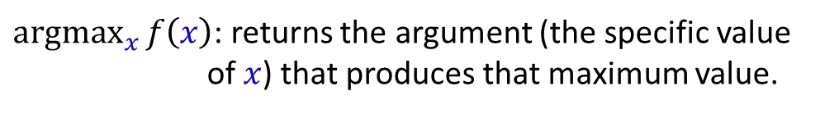
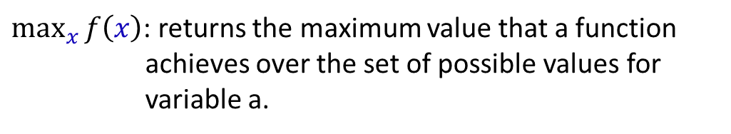
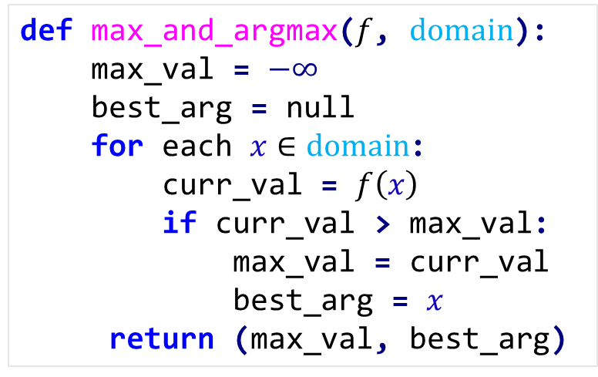

Value Iteration
The Bellman equations give us a mathematical relationship, but we need an algorithm to actually compute the optimal values.
Idea: Iteratively improve value estimates using Bellman equation
Key insight: If we keep applying the Bellman operator, our value estimates will converge to the optimal values!
Clarifying Notation
def max_and_argmax($f$, $domain$):
max_val = $−∞$
best_arg = null
for each $x∈domain$:
curr_val = $f\left(x\right)$
if curr_val > max_val:
max_val = curr_val
best_arg = $x$
return (max_val, best_arg)
$\max_{x}{f\left(x\right)}$: returns the maximum value that a function achieves over the set of possible values for variable a.
$\underset{x}{argmax}{f\left(x\right)}$: returns the argument (the specific value of $x$) that produces that maximum value.
Observe, these are both implied loops over all $x$.

Slide 32

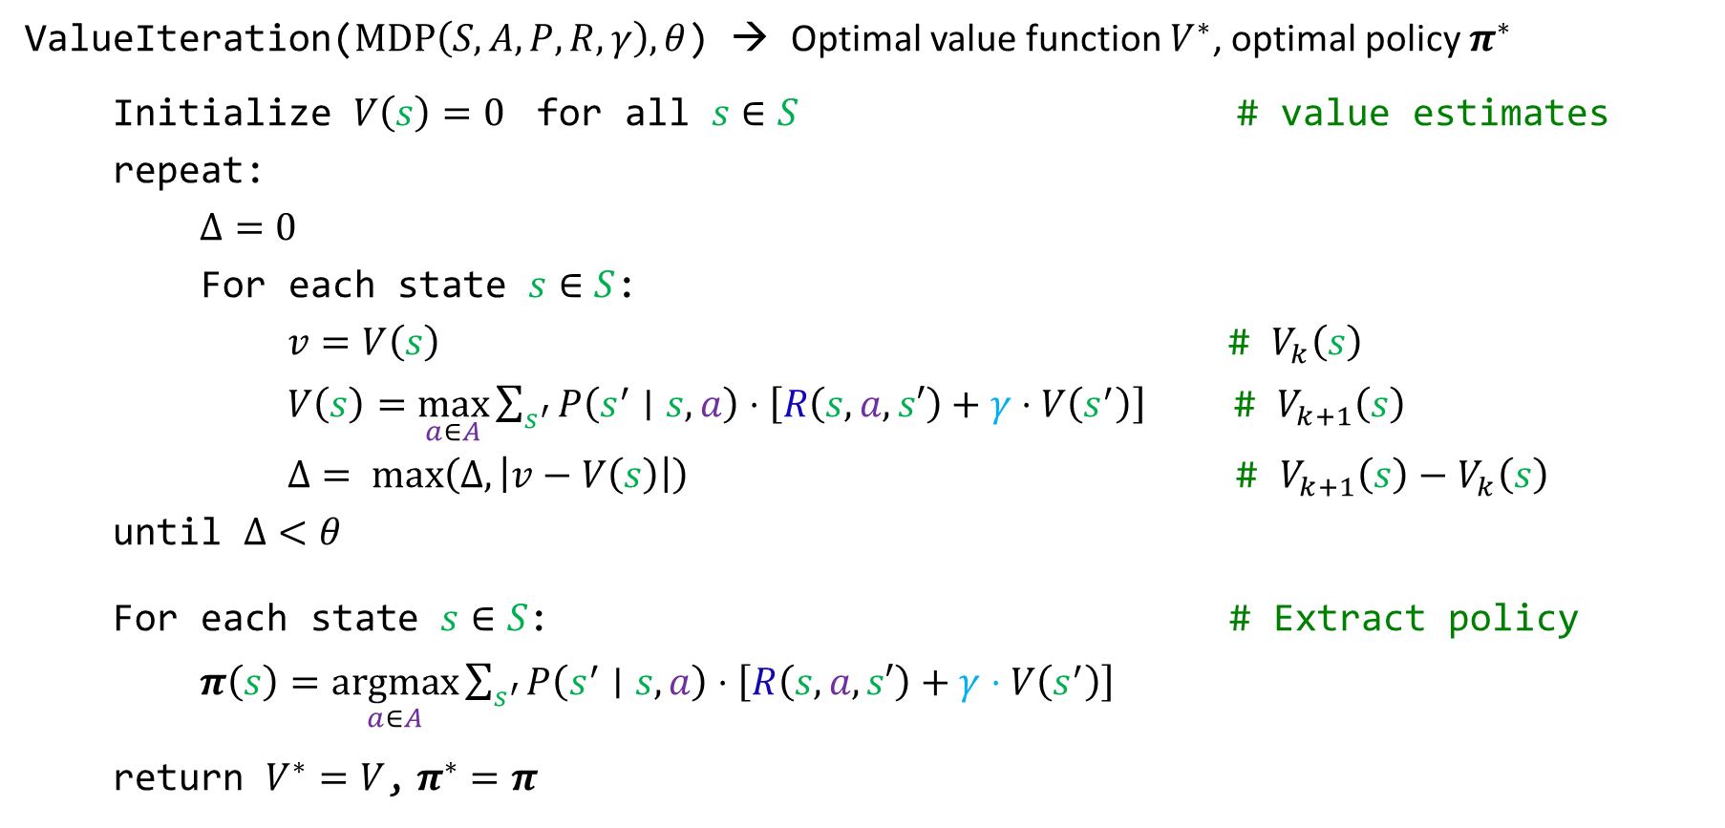



Value Iteration Algorithm
ValueIteration($MDP\left(S, A, P, R, γ\right),θ$) → Optimal value function $V^{∗}$, optimal policy $π^{∗}$
Initialize $V\left(s\right)=0$ for all $s∈S$ # value estimates
repeat:
$Δ=0$
For each state $s∈S$:
$v=V\left(s\right)$ # $V_{k}\left(s\right)$
$V\left(s\right)=\max_{a∈A}{\sum_{s^{′}}{P\left(s^{′}∣s,a\right)⋅\left[R\left(s,a,s′\right)+γ⋅V\left(s^{′}\right)\right]}}$ # $V_{k+1}\left(s\right)$
$Δ= max\left(Δ,\left|v−V\left(s\right)\right|\right)$ $\text{\#} V_{k+1}\left(s\right)−V_{k}\left(s\right)$
until $Δ<θ$
For each state $s∈S$: # Extract policy
$π\left(s\right)=\underset{a∈A}{argmax}\sum_{s^{′}}{P\left(s^{′}∣s,a\right)⋅\left[R\left(s,a,s′\right)+γ⋅V\left(s^{′}\right)\right]}$
return $V^{∗}=V$, $π^{∗}=π$
$$O\left(\left|S\right|\right)$$
$$O\left(\left|A\right|\left|S\right|\right)$$
Convergence: Guaranteed for $0<γ<1$
Complexity: $O\left({\left|S\right|}^{2}\left|A\right|\right)$ per iteration

Slide 33
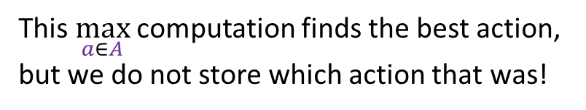
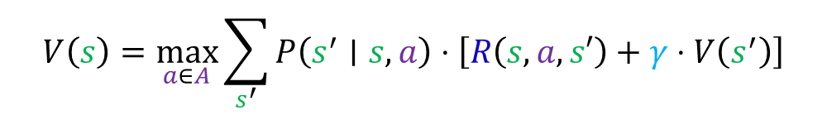
Policy Iteration
The Problem (‘Waste’ with Value iteration’s). Each iteration, you compute the best action for every state, but then we throw away all that policy information and recompute it from scratch next time.
$$V\left(s\right)=\max_{a∈A}{\sum_{s^{′}}{P\left(s^{′}∣s,a\right)⋅\left[R\left(s,a,s′\right)+γ⋅V\left(s^{′}\right)\right]}}$$
This $\max_{a∈A}$ computation finds the best action, but we do not store which action that was!
Policy Iteration* Idea: Instead of finding optimal values first, alternate between evaluating and improving the current policy.
* Often faster than value iteration in practice

Slide 34



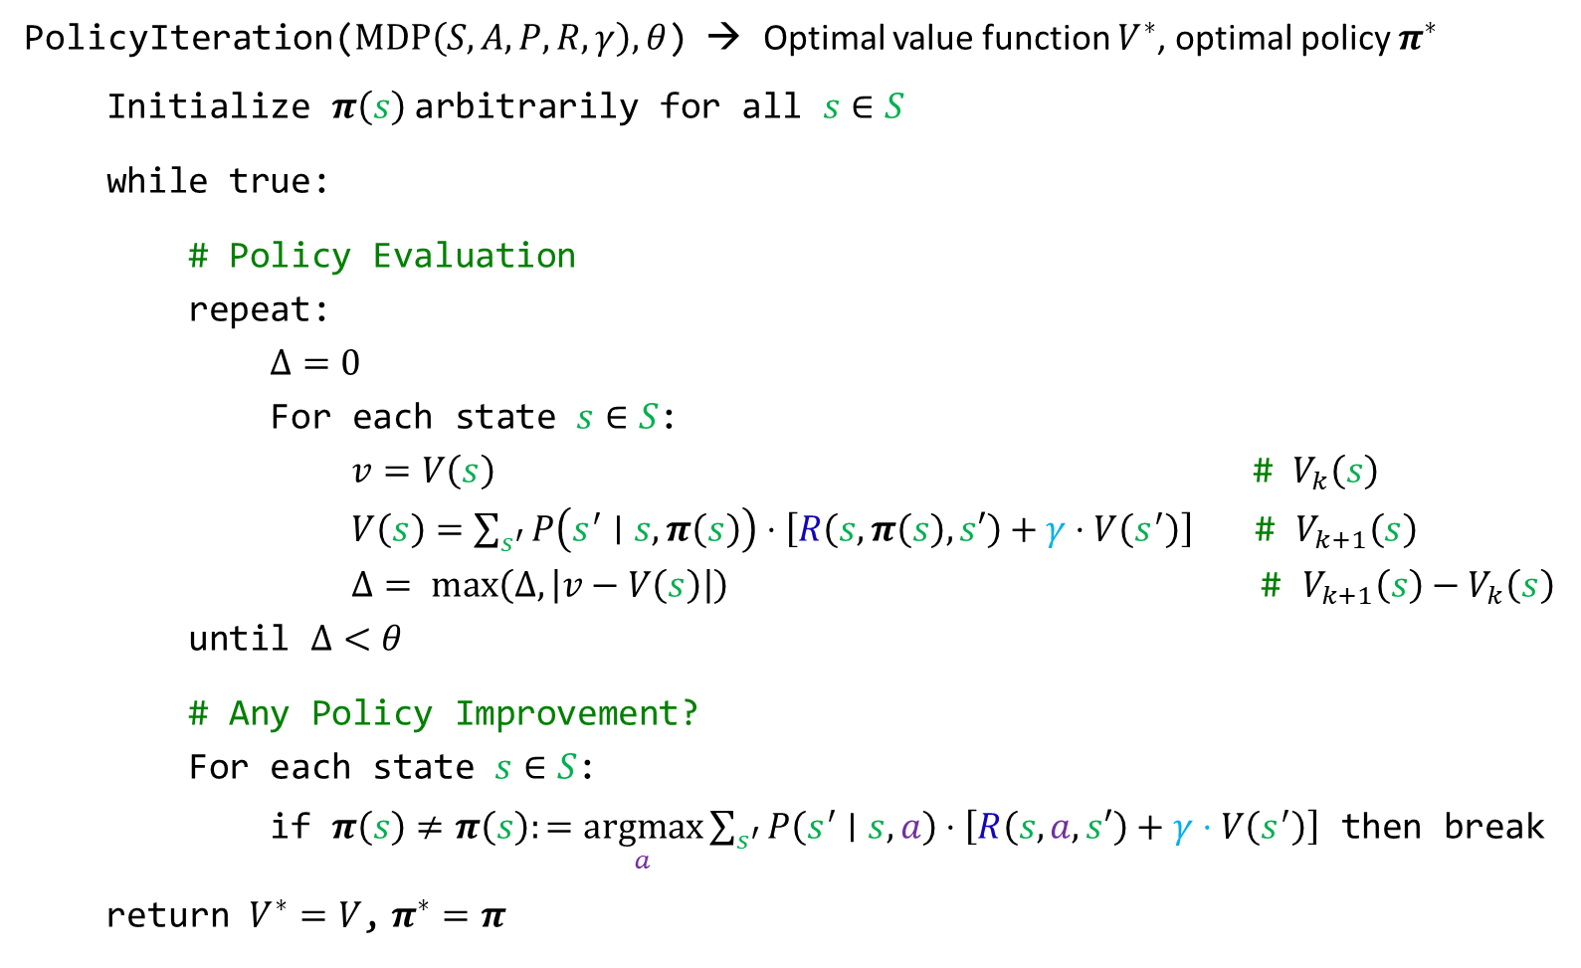





Policy Iteration Algorithm
PolicyIteration($MDP\left(S, A, P, R, γ\right),θ$) → Optimal value function $V^{∗}$, optimal policy $π^{∗}$
Initialize $π\left(s\right)$arbitrarily for all $s∈S$
while true:
# Policy Evaluation
repeat:
$Δ=0$
For each state $s∈S$:
$v=V\left(s\right)$ # $V_{k}\left(s\right)$
$V\left(s\right)=\sum_{s^{′}}{P\left(s^{′}∣s,π\left(s\right)\right)⋅\left[R\left(s,π\left(s\right),s′\right)+γ⋅V\left(s^{′}\right)\right]}$ # $V_{k+1}\left(s\right)$
$Δ= max\left(Δ,\left|v−V\left(s\right)\right|\right)$ $\text{\#} V_{k+1}\left(s\right)−V_{k}\left(s\right)$
until $Δ<θ$
# Any Policy Improvement?
For each state $s∈S$:
if $π\left(s\right)≠π\left(s\right):=\underset{a}{argmax}\sum_{s^{′}}{P\left(s^{′}∣s,a\right)⋅\left[R\left(s,a,s′\right)+γ⋅V\left(s^{′}\right)\right]}$ then break
return $V^{∗}=V$, $π^{∗}=π$
$$O\left(k\right)$$
$$⋅$$
$$O\left(\left|S\right|\right)$$
$$⋅$$
$$O\left(\left|S\right|\right)$$
$$=$$
$$O\left(k{\left|S\right|}^{2}\right)$$
$$O\left(\left|A\right|{\left|S\right|}^{2}\right)$$

Slide 35
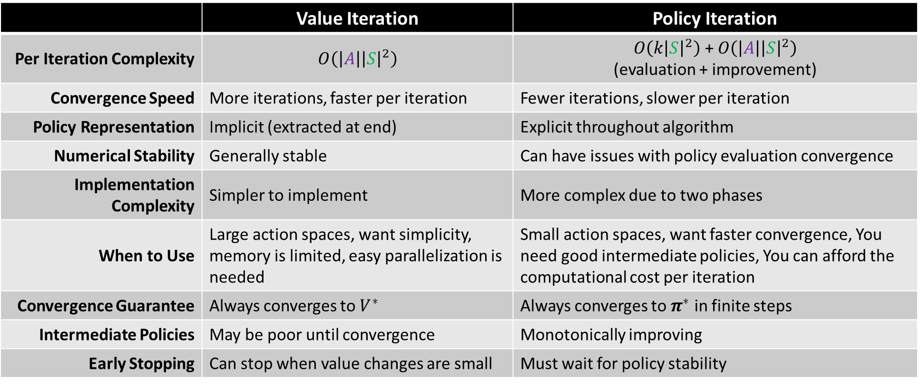
Comparing Value Iteration with Policy Iteration
 | Value Iteration | Policy Iteration
Per Iteration Complexity | $$O\left(\left|A\right|{\left|S\right|}^{2}\right)$$ | $O\left(k{\left|S\right|}^{2}\right)$ + $O\left(\left|A\right|{\left|S\right|}^{2}\right)$ (evaluation + improvement)
Convergence Speed | More iterations, faster per iteration | Fewer iterations, slower per iteration
Policy Representation | Implicit (extracted at end) | Explicit throughout algorithm
Numerical Stability | Generally stable | Can have issues with policy evaluation convergence
Implementation Complexity | Simpler to implement | More complex due to two phases
When to Use | Large action spaces, want simplicity, memory is limited, easy parallelization is needed | Small action spaces, want faster convergence, You need good intermediate policies, You can afford the computational cost per iteration
Convergence Guarantee | Always converges to $V^{∗}$ | Always converges to $π^{∗}$ in finite steps
Intermediate Policies | May be poor until convergence | Monotonically improving
Early Stopping | Can stop when value changes are small | Must wait for policy stability

Slide 36
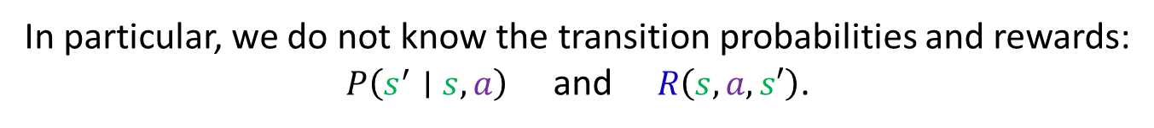
When the Model is Unknown
Value and Policy iteration make one bold assumption…
that we know the Markov Decision Process model.
In particular, we do not know the transition probabilities and rewards:
$P\left(s^{′}∣s,a\right)$ and $R\left(s,a,s′\right)$.
In the real world, we often do not have access to this information.
So how can we learn optimal behavior through experience alone?
Fundamentally, how do we move from a model-based learning to model-free learning?

Slide 37
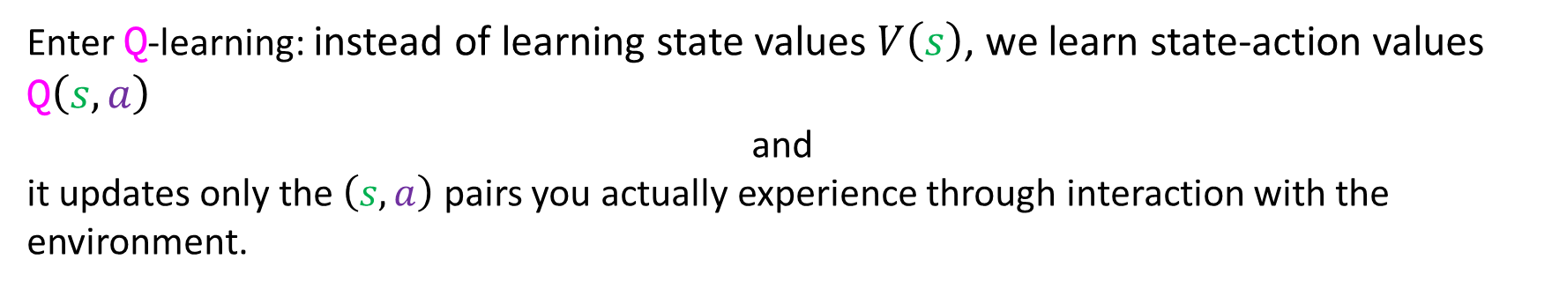
Q-Learning
What if we could perform value iteration without knowing the model?"
Recall that value iteration systematically considers all state/action pairs in each iteration—it sweeps through every $\left(s,a\right)$ pair and updates values based on the full model.
What if we selected which pairs of interest?
Enter Q-learning: instead of learning state values $V\left(s\right)$, we learn state-action values Q$\left(s,a\right)$
and
it updates only the $\left(s,a\right)$ pairs you actually experience through interaction with the environment.

Slide 38
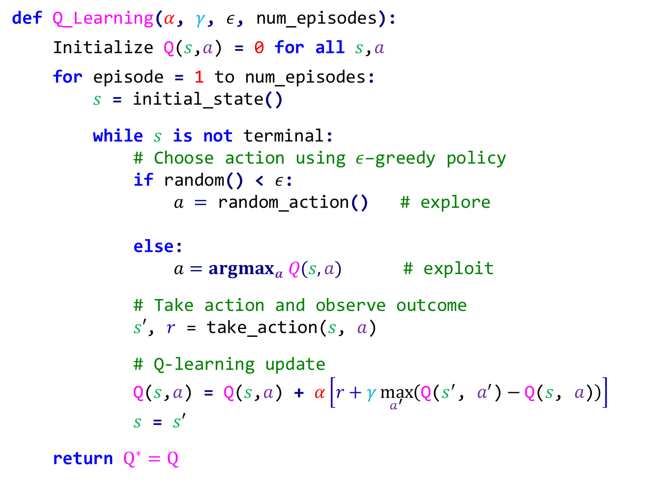



Q-Learning Algorithm ($ε$-Greedy)
def Q_Learning($α$, $γ$, $ε$, num_episodes):
Initialize Q($s$,$a$) = 0 for all $s$,$a$
for episode = 1 to num_episodes:
$s$ = initial_state()
while $s$ is not terminal:
# Choose action using $ε$–greedy policy
if random() < $ε$:
$a =$ random_action() # explore
else:
$a=argmax_{a} Q(s,a)$ # exploit
# Take action and observe outcome
$s′$, $r$ = take_action($s$, $a$)
# Q-learning update
Q($s$,$a$) = Q($s$,$a$) + $α\left[r+γ\max_{a^{′}}\left(\text{Q}\text{(}s^{′}\text{, }a^{′}\text{)}−\text{Q}\text{(}s\text{, }a\text{)}\right)\right]$
$s$ = $s′$
return $Q^{∗}=Q$
$α$: learning rate
$γ$: discount factor
$ε$: exploration factor
A goal state or state with no outgoing actions
Temporal difference

Slide 39
Exploration vs Exploitation
Q-learning is elegant, but there’s a catch: how do we choose actions while learning? If we always exploit our current knowledge, we might miss better actions. If we always explore randomly, we might never use what we’ve learned. This is one of the central challenges in RL…
The eternal dilemma: Should I try something new (explore) or do what I know works (exploit)?
Exploitation: Choose action that seems best given current knowledge Exploration: Try actions to gain more information
ε-Greedy Strategy
  With probability ε: choose random action (explore)
  With probability 1-ε: choose best action (exploit)
Other strategies:
  Boltzmann/Softmax: P(a) ∝ exp(Q(s,a)/τ) with temperature τ
  Upper Confidence Bounds (UCB): Choose argmax_a [Q(s,a) + c√(ln(t)/N(s,a))]
  Thompson Sampling: Bayesian approach using posterior distributions
  Optimistic initialization: Start with high Q-values to encourage exploration
  Count-based exploration: Bonus for rarely visited state-action pairs
  Curiosity-driven exploration: Intrinsic motivation based on prediction error
Exploration Bonuses Example:
# UCB exploration bonus
bonus = c * sqrt(log(total_visits) / action_visits)
action_value = Q(s,a) + bonus

Slide 40
SARSA vs Q-Learning
Q-learning makes a bold assumption: it learns what the optimal policy would do, regardless of what policy it’s actually following. But what if we want to learn about the policy we’re actually executing? This leads us to SARSA…
Key difference: On-policy vs off-policy learning
SARSA (On-policy)
Q(s,a) ← Q(s,a) + α[r + γQ(s’,a’) - Q(s,a)] - Updates using actual action taken (a’) - Learns value of policy being followed
Q-Learning (Off-policy)
Q(s,a) ← Q(s,a) + α[r + γ max_{a’} Q(s’,a’) - Q(s,a)] - Updates using best possible action - Learns optimal policy regardless of behavior policy

Slide 41
Deep Q-Networks (DQN)
Traditional Q-learning works great for small problems, but what about Atari games with millions of possible states? We can’t store a table with millions of entries. This is where deep learning comes to the rescue…
Scaling challenge: How to handle massive state spaces?
Challenge: Q-tables infeasible for large state spaces
Solution: Use neural networks to approximate Q(s,a)
Key innovations:
  Experience Replay: Store and sample from experience buffer
  Target Network: Separate network for computing targets
  Convolutional layers: Process high-dimensional inputs (images)
Loss function:
L(θ) = E[(r + γ max_{a’} Q(s’,a’;θ⁻) - Q(s,a;θ))²]

Slide 42
Summary
We’ve covered a lot of ground! Let’s consolidate what we’ve learned about this powerful learning paradigm…
Key Concepts:
  RL framework: Agent-environment interaction
  MDPs: Mathematical formulation of RL problems
  Value functions: Expected future rewards
  Bellman equations: Recursive relationships
  Dynamic programming: Value/policy iteration
  Temporal difference learning: Model-free methods
  Deep RL: Neural network function approximation
Next Steps:
  Advanced algorithms (policy gradients, actor-critic)
  Multi-agent reinforcement learning
  Applications in robotics and game AI

